Slide 1
NFT Borrowing
Like all other expensive things in life, you can now also borrow NFTs
-By Natasha Rupani

Slide 2

Pleased to meet you!
I’m an eager beaver who loves the thrill of exploring new technologies.
Blockchain Development, Fintech from George Brown College
Data Analysis and Statistical Inference from Duke University
R programming from Johns Hopkins University
Data Science from Johns Hopkins
With a Masters of Information Management degree from Mumbai University I bring a unique perspective that combines my technology skills with my obsession to organize and plan! Yes Obsession!
I have 9 years of experience in Software development, consulting and management, and I love to meet new people, talk to them and listen intently.

Slide 3
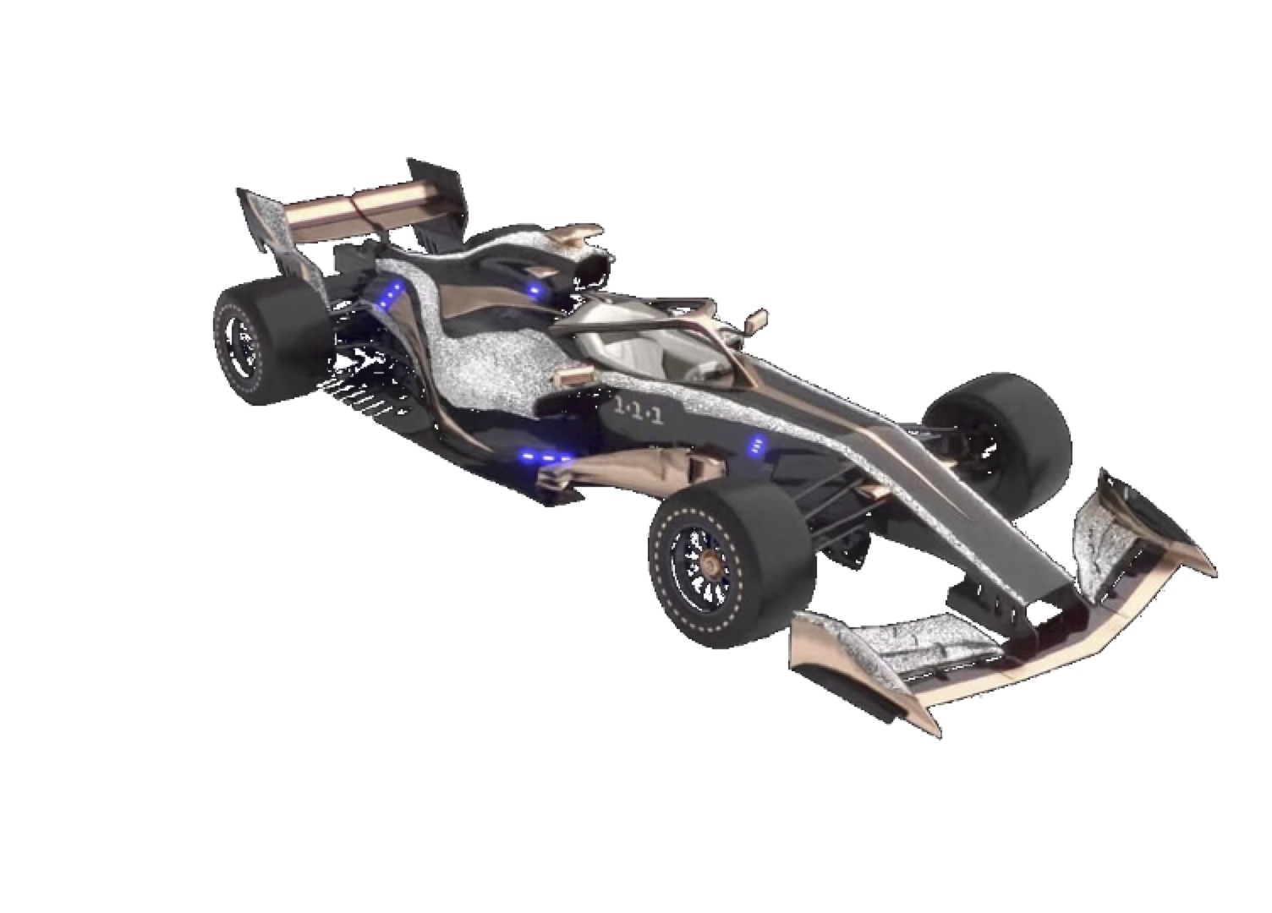
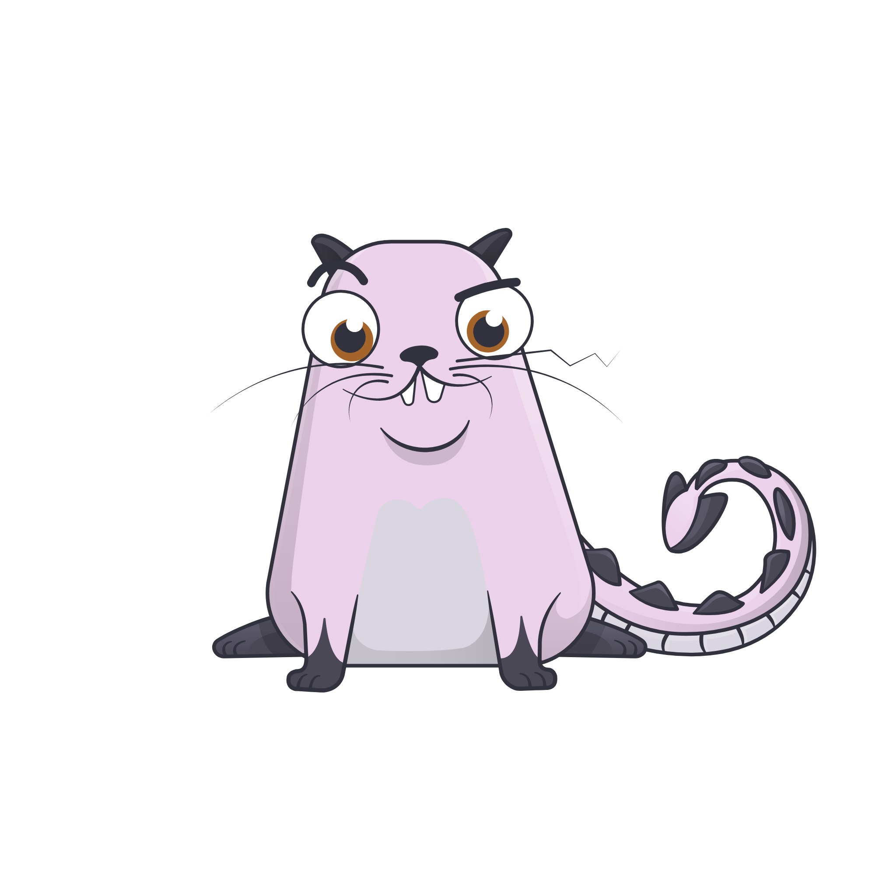
NFT the buzz word! But not everyone can afford it.
Beeple’s “Everydays – The First 5000 days” sold for $69 million in March 2021 ^{[1]}
Like we rent a limo for a prom, how about renting a Non fungible token for a day or two?
Imagine renting a race car, worth $110,000 (May 2019) The F1 1-1-1 used in F1 Delta Time game or maybe you can borrow one of the cryptokitties for breeding, you can finally breed your 3rd generation kitty with a dragon kitty!

Slide 4
How?
Lease your NFTs for a fix period for a fix rent. If the borrower defaults, you not only get the rent but also the collateral!
Every time a lease is accepted the collateral is stored in the smart contract that acts as the escrow, so all leasing is safe plus everything is one a public blockchain for added transparency.
Technologies used: React,web3, Opensea API, Materials UI design, Blockchain, truffle, Rinkeby testnet
Benefits
Earn passive income on your NFTs
Borrow NFTs for your use at a reasonable rent.
Help create an NFT economy
Its Peer to peer solution on an open blockchain that is completely transparent.

Slide 5
Let me show you how
Demo

Slide 6
What’s next?
NFT as collateral – get money against your NFTs, quick instant loans. Once you pay the loan back your NFT is yours.
Challenges:
Value of NFT is too volatile to be used as a collateral.
Some NFTs loose value over time or when used. What if a collateral losses all its value during the loan period, the borrower then has no incentive to repay the loan
NFT derivatives can get very complicated.
Further research is required to create a robust NFT loan system

Slide 7


Penny for your thoughts?
Please drop me a note, I would love to hear from you, your feedback, suggestions, comments and constructive criticism are all welcome.
Thank you for your time.
Citation:
Research paper by Dragos I. Musan: Leveraging-Non-Fungible-Tokens.pdf

